Slide 1

MISY 650 : Security and Control
IT Risk Assessment
ABC Security Inc.
Presented by: Group 3
Henry Chan
Rishabh Jagtap
Shailendra Rathore
University of Delaware

Slide 2
About “ABC”
“ABC” is based in San Francisco, CA.
The company provides a leading cloud-native email security platform that leverages AI-based behavioral data science to stop socially-engineered and never-seen-before email attacks that evade traditional secure email gateways.
“ABC” delivers a fundamentally different approach that precisely detects and protects against the widest range of attacks including business email compromise, phishing, malware, ransomware, social engineering, spam, supply chain compromise, and internal account compromise.
The “ABC” platform delivers inbound email security, internal and external account takeover protection, and full automation. ABC’s API-based approach enables customers to get started in minutes be used standalone to enhance native cloud email security protection with Microsoft 365 and Google Workspace.

Slide 3
Executive Summary
IT risk assessment done for company “ABC”.
“ABC” is a leading cybersecurity firm specializing in email security.
The company has been engaged by “University of Delaware” to detect and prevent a range of email-based threats, including phishing and business email compromise.
Our team evaluated the assets and threats associated with ABC’s email security platform.
Basis the likelihood of each identified vulnerability and its potential impact, risk score was calculated providing a quantitative basis for the assessment.
The team identified the highest risks and suggested countermeasures and recommendations for the management of ABC.
By implementing the proposed controls, ABC can strengthen its defenses, reduce the likelihood of successful email attacks, and optimize its overall cybersecurity investment.

Slide 4
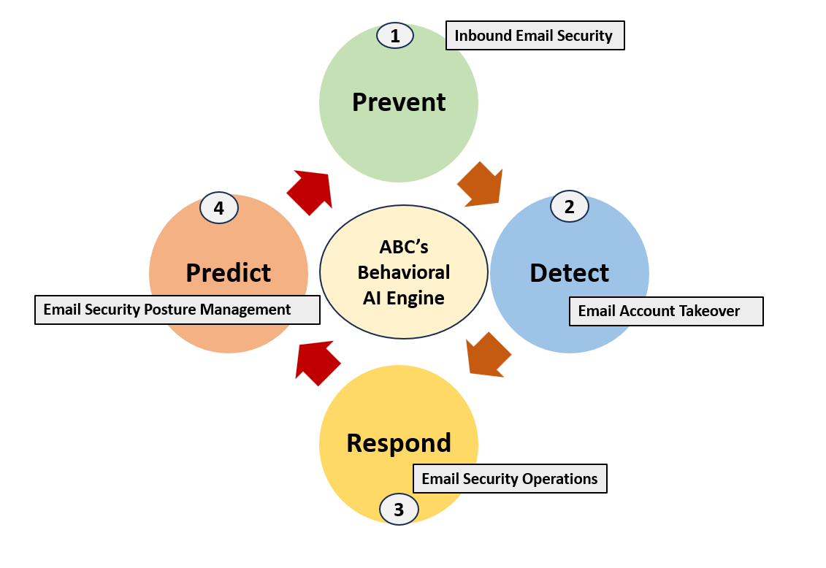
ABC’s Behavioral AI Engine

Slide 5
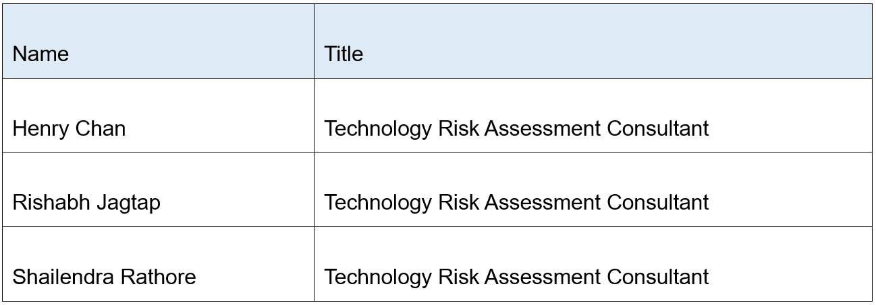
Scope
Recognizing the criticality of the email security landscape and the potential severe impact of email attacks, the risk assessment covers both the email security platform itself and the broader processes involved.
The assessment aims to ensure a comprehensive understanding of potential threats and vulnerabilities associated with Company ABC's innovative solution.
Team

Slide 6
Risk Assessment Approach
DATA COLLECTION & DOCUMENTATION
RISK MATRIX DEVELOPMENT & ASSESSMENT
RISK LEVEL METRICS AND CLASSIFICATION
INITIAL ASSESSMENT
RISK SCORING SYSTEM
1
2
3
4
5

Slide 7
Initial Assessment
The information gathering process was conducted via review of the documentation available in the website of ABC.
Clear descriptions of the existing systems, users interactions, system integrity, network diagrams and operational manuals related to email security system.
While looking at the documentation, we had the questions recommended by the National Institute of Standards and Technology as a reference in mind to help us extract the right information.
Supporting diagrams and system architectures were part of the documentation and have been used in conducting the risk assessment.
Data Collection and Documentation
The data collection and documentation were tailored for business specifics.
Captured insights related to current procedures, controls, user access processes, system integrity, database administration, and audit.
Supporting documentation and flowcharts were foundational for the risk assessment.

Slide 8
Risk Matrix Development and Assessment
Following a detailed review of documentation, the team structured risk metrics based on potential threats and vulnerabilities associated with ABC email security system and process.
All assets interacting with the ABC network, such as servers, terminals, controllers, software, and personnel were identified.
Each asset impacted had identified threats and vulnerabilities, and a risk score was assigned based on the severity and probability (likelihood) of occurrence.
Subsequently, the team compiled findings and constructed a matrix to document and rate the potential severity of each identified threat.

Slide 9
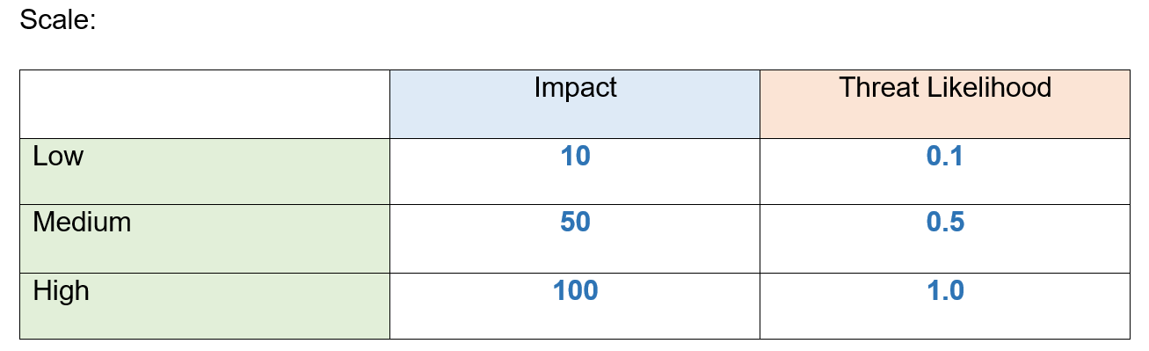
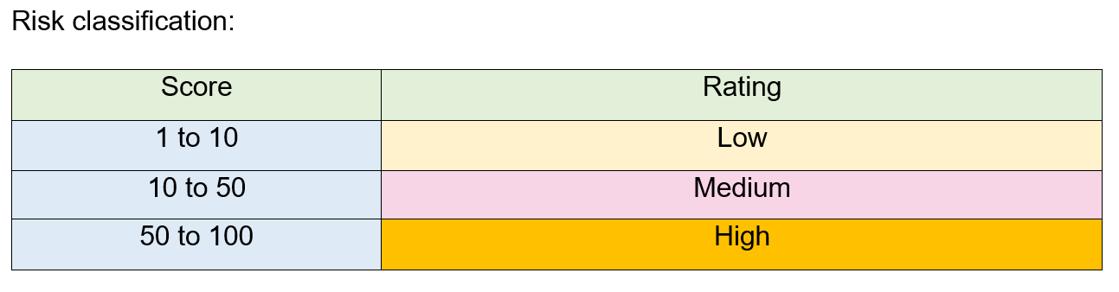
Risk Scoring Classification

Slide 10
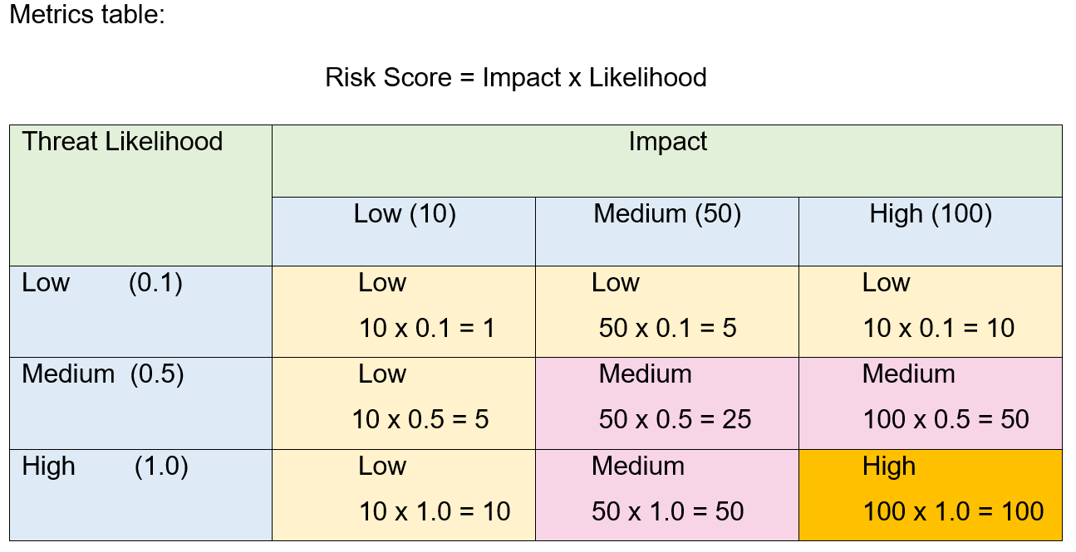
Risk Scoring Classification

Slide 11
Risk - Level Metrics and Classification
A Risk-Level Metrics system was employed to generate risk ratings.
Categorizing them as:
Risk | Scores | Follow up Action Required
Low | 1 to 10 | The company can decide whether to develop an action plan o r accept the risk.
Medium | 10 to 50 | While the system can continue operating, an action plan is required within a reasonable timeframe. Medium-risk issues are closely monitored as they can escalate
High | > 50 | A score higher than 50, necessitating immediate action. While the system can continue operating, an action plan must be developed and executed promptly.

Slide 12
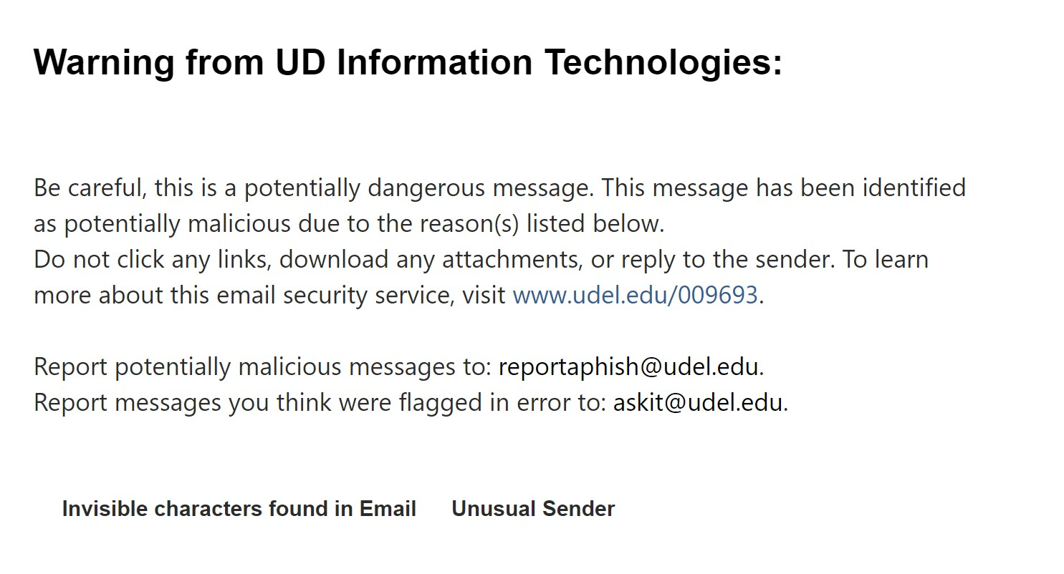
System Characterization
Function:
Mainly use behaviorally AI and Machine Learning
Able to learn “good behavior”
Over thousands of unique signals
Adaptable
Will notified you when you are received an malicious email
Filtering between safe, spam, and malicious

Slide 13
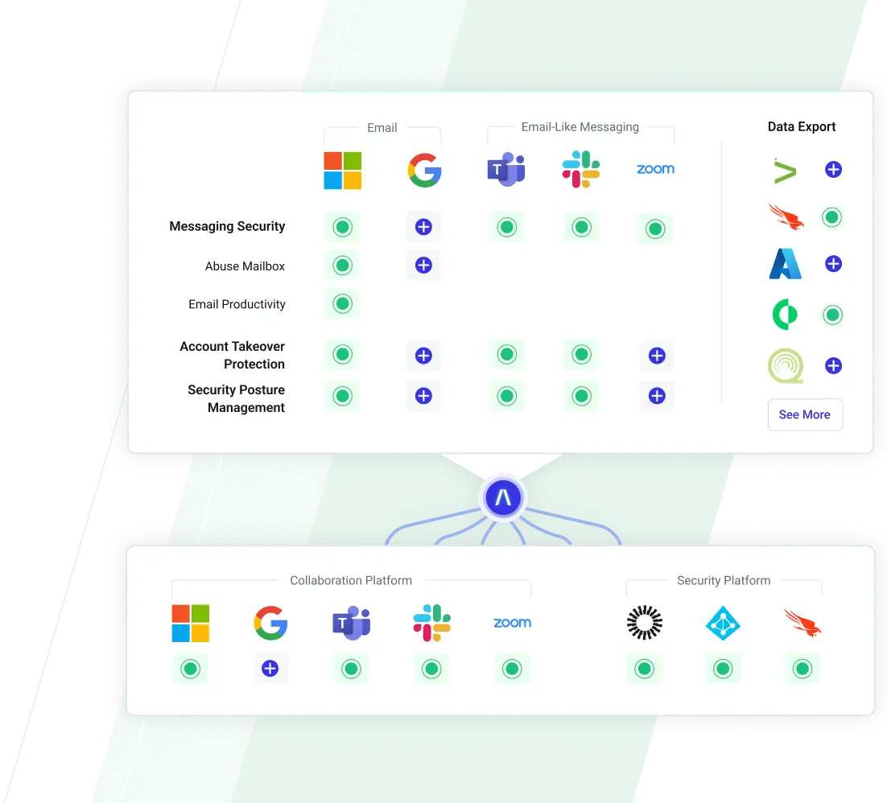
System Characterization
Features
Can integrate multiple cloud email environment without interruptions.
Reduce totals costs
Examine behaviors across other third-party applications

Slide 14

Threat Statement
Lists of Threats
External hackers
Insider Threats
Business Partners
Employee Negligence
State-Sponsored Actors
Competitors
Disgruntled Employees

Slide 15
Threat Statement
The Most Dangerous Threats
We believe that these are the top threats to the ABC company.
Email Server - most important asset of the ABC company. Probably be exploited by state-sponsored actors. If compromised, the entire architecture will fall
Customer Email Data - can be received by external hackers. It will drastically increase the number of malicious emails by spoofing the stolen info.
Threat Intelligence - caused by insider threats. Either caused by disgruntled employees or hostile insider. Exposure to sensitive information will be used for malicious purposes.

Slide 16
Risk Assessment Results
The purpose of this risk assessment is to systematically evaluate potential threats to our organization's security and identify vulnerabilities that may compromise the integrity, confidentiality, or availability of our critical assets. By conducting this assessment, we aim to proactively manage and mitigate risks, ensuring the robustness of our security posture.
The top 3 risks as determined by the total risk score are enumerated below
The Email Server faces severe vulnerability without regular patching, at high risk of exploitation by state-sponsored actors. A threat likelihood of 1.0 and a risk score of 100 demand immediate mitigation. Swift measures are crucial to secure the server, mitigate exploitation, and maintain communication integrity, emphasizing the need for prompt patching to counter state-sponsored threats.
Customer Email Data is at risk due to insufficient encryption, exposing it to potential unauthorized access by external hackers. Despite a moderate likelihood (0.5), the risk score of 50 demands immediate attention. Mitigation requires robust encryption, continuous monitoring, and transparent communication with customers. Swift action is vital to secure customer information and maintain compliance with data protection standards.
Threat Intelligence is at risk with inadequate monitoring, risking unauthorized access by employees. The impact is high, affecting data confidentiality. With a moderate likelihood (0.5) and a risk score of 50, urgent mitigation is required. Strategies include enhanced monitoring, access restrictions, and transparent communication. Swift action is imperative to secure threat data and uphold security integrity.

Slide 17
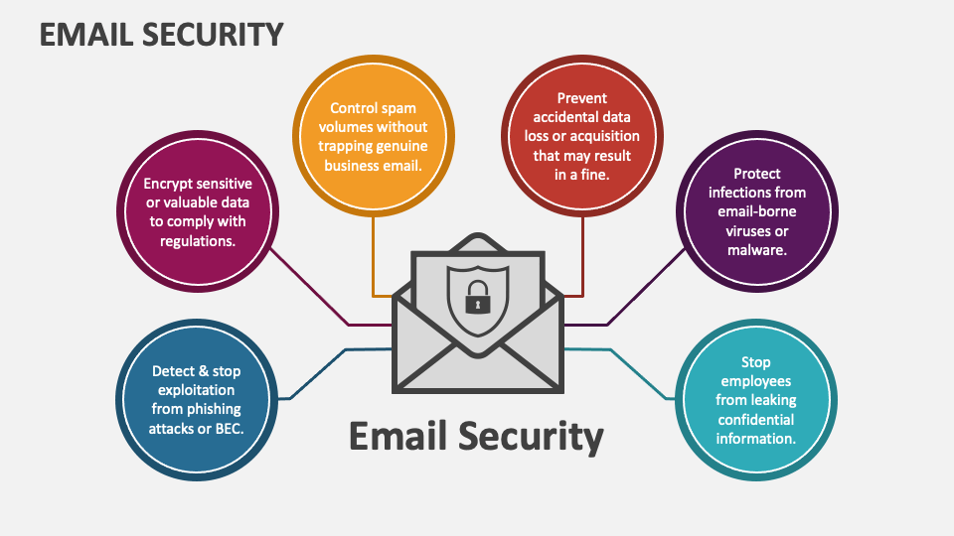
Risk Assessment Results
Example : Risk assessment
Email Server Risk
Information Asset : Email Server
Vulnerability : Lack of Regular Patching
Threat Source : State-sponsored Actors
Threat Action : Exploitation of Unpatched Systems
Impact: High (The potential consequences of a successful exploitation are severe, with a significant impact on confidentiality, integrity, and availability of our email server)
Threat Likelihood: 1.0 (The likelihood of a state-sponsored actor exploiting the unpatched system is considered extremely high, emphasizing the urgency of addressing this vulnerability)
Tentative Risk Score:100(The high impact combined with a certain likelihood results in a critical risk score of 100, signifying an immediate need for mitigation)

Slide 18
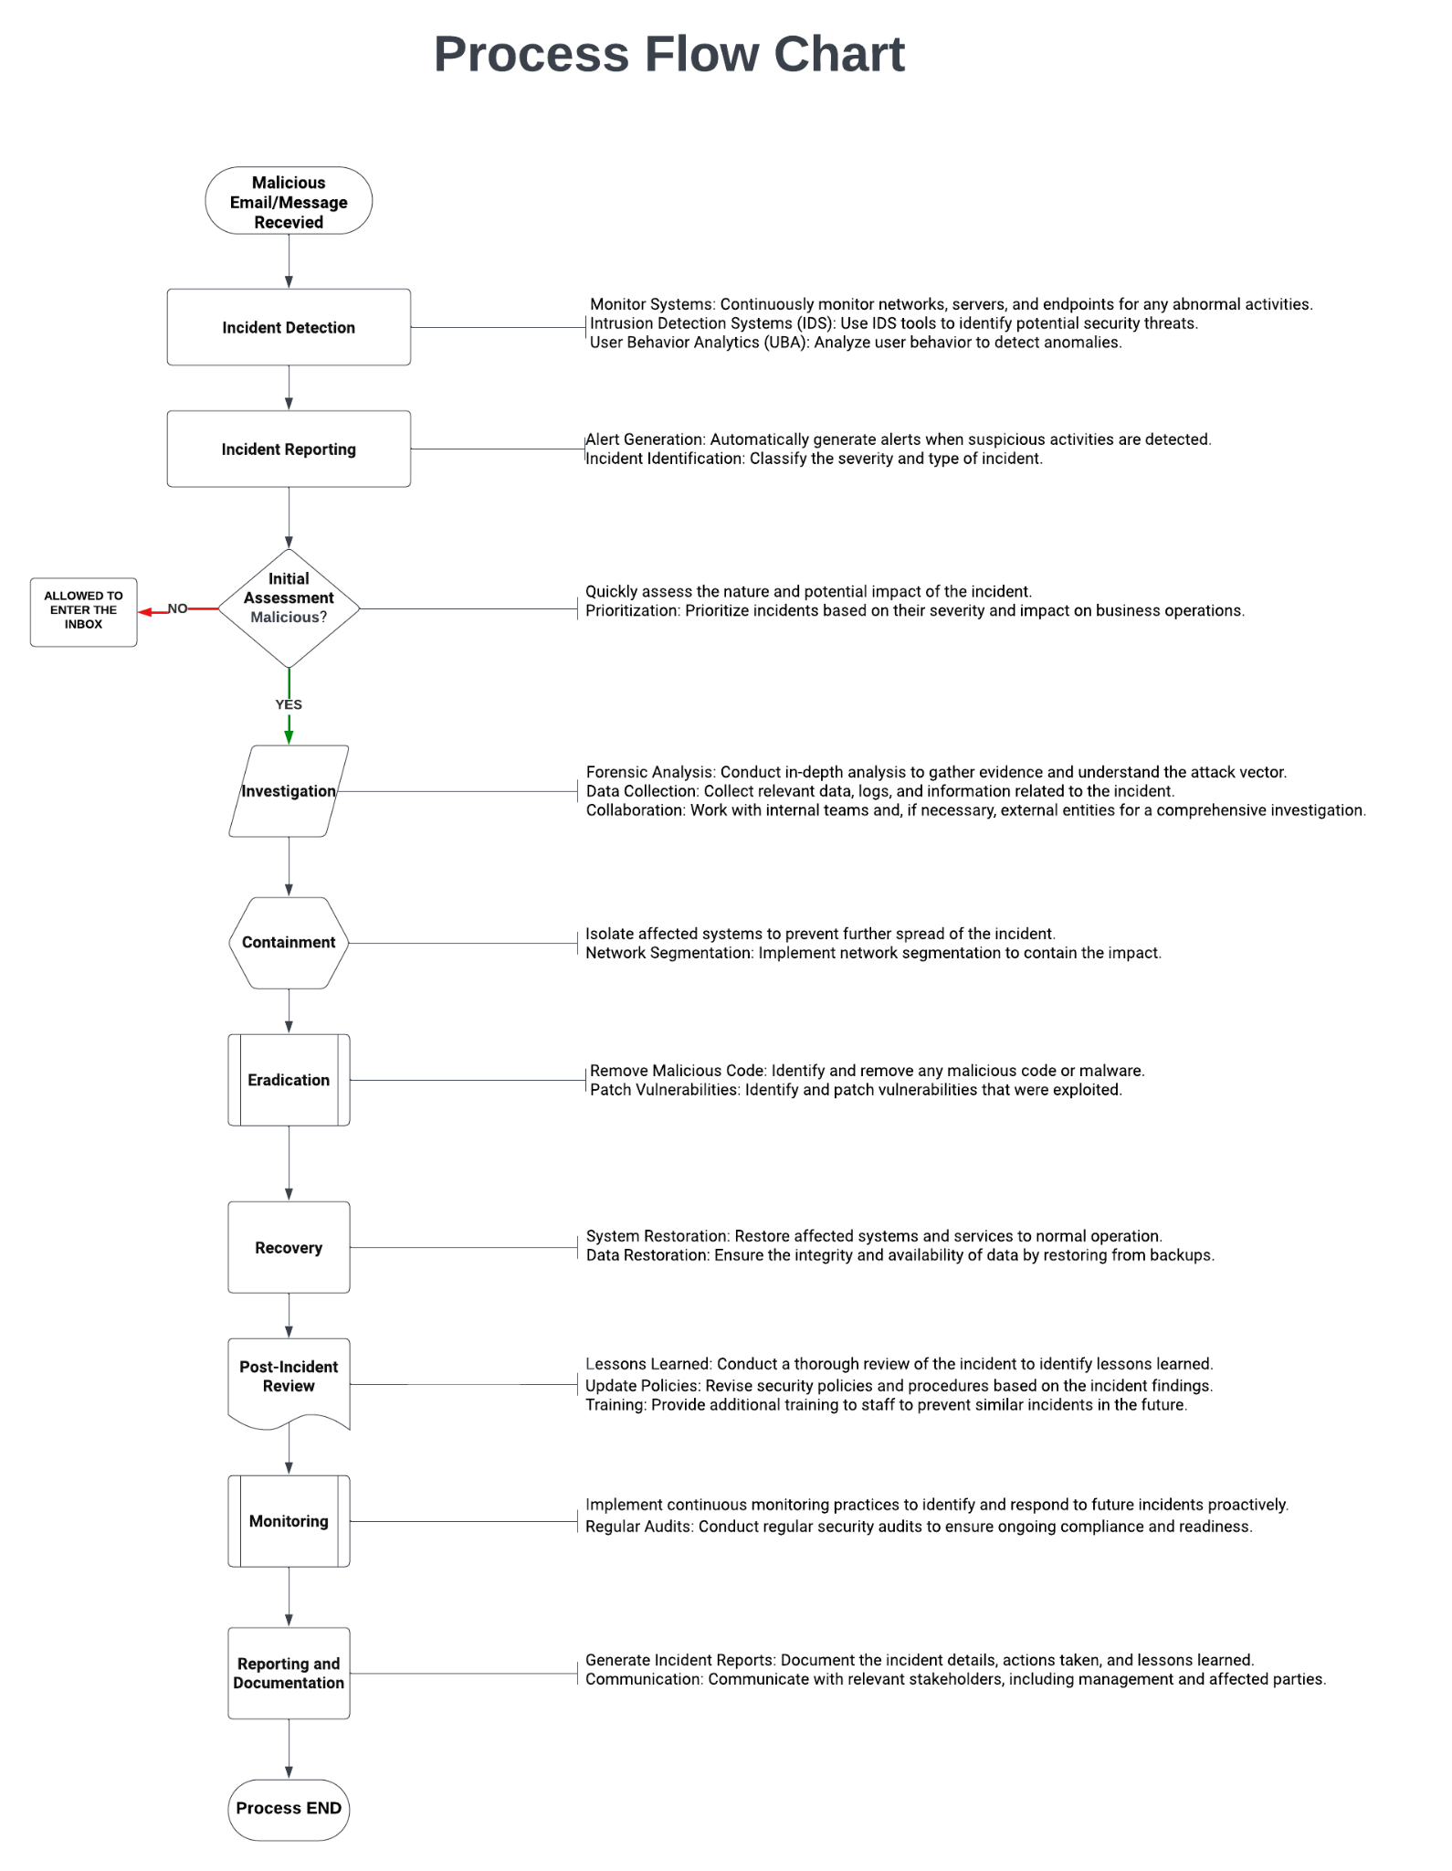
Appendix A Process flow chart
ABC IT Security Company is committed to ensuring robust and efficient security measures to safeguard against abnormal threats in the digital landscape. This process flow chart outlines the systematic approach employed by the company to address and mitigate abnormal security incidents effectively.

Slide 20
The Process Flow Chart for ABC IT Security Company underscores our commitment to proactively address abnormal security threats. By leveraging advanced detection, rapid response, and continuous improvement, we ensure the resilience of our systems and the protection of our clients from emerging security challenges. This systematic approach reflects our dedication to staying ahead in the ever-evolving landscape of digital security.

Slide 21
Appendix B Risk table
Risk management is crucial for information security, involving identification, assessment, and mitigation of potential risks.
The risk table provides a structured approach for analyzing and quantifying risks related to information assets, vulnerabilities, threats, and their potential impact.
Information Asset | Vulnerability | Threat Source | Threat Action | Impact | Threat Likelihood | Tentative Risk Score
Customer Email Data | Insufficient Encryption | External Hackers | Unauthorized Access | High | 0.5 | 50
Email Filtering System | Outdated Software | Insider Threats | Manipulation of Filter Settings | Medium | 0.5 | 25
Customer Contact Information | Phishing Vulnerability | Business Partners | Spoofed Emails for Impersonation | High | 0.1 | 10
Employee Credentials | Weak Passwords | Employee Negligence | Credential Theft | Medium | 0.5 | 25

Slide 22
Information Asset | Vulnerability | Threat Source | Threat Action | Impact | Threat Likelihood | Tentative Risk Score
Email Server | Lack of Regular Patching | State-sponsored Actors | Exploitation of Unpatched Systems | High | 1.0 | 100
Security Policies | Lack of Employee Training | Competitors | Social Engineering Attacks | Medium | 0.5 | 25
Threat Intelligence | Inadequate Monitoring | Disgruntled Employees | Unauthorized Access to Threat Data | High | 0.5 | 50
The risk table aids organizations in prioritizing and addressing security concerns based on the potential impact and likelihood of occurrence.
Regular updates and adjustments are essential to adapt to the evolving threat landscape and emerging vulnerabilities.

Slide 23
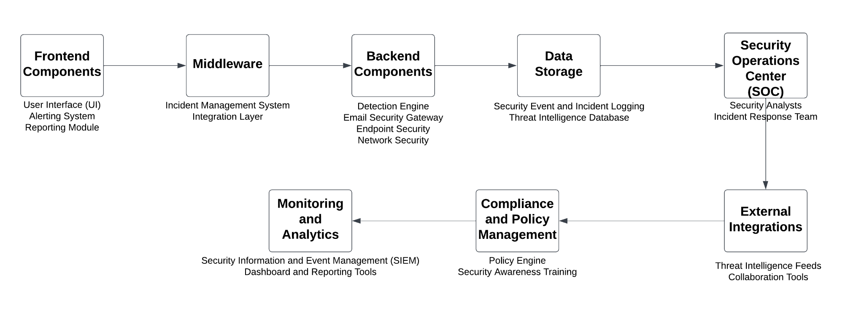
Appendix C Basic System Architecture
The basic system architecture for an ABC an email security company involves a combination of hardware, software, networks, and processes designed to detect, prevent, and respond to security threats.

Slide 24
Explanation : Security System Components
1. Frontend:
UI Dashboard:Enables security analysts to monitor and manage alerts.
Alerting System:Sends real-time alerts for detected anomalies.
Reporting Module: Generates detailed reports on incidents and performance.
2. Middleware:
Incident Management: Orchestrates incident workflow, ensuring effective resolution.
Integration Layer:Connects with external tools for threat intelligence and incident response.
3.Backend Components:
Detection Engine:Anomaly Detection: Uses machine learning to identify abnormal patterns Behavioral Analytics: Analyzes user behavior for deviations.Threat Intelligence Integration: Enhances detection with threat feeds.
Email Security Gateway:Anti-Spam and Anti-Phishing: Filters emails to block spam and phishing.Attachment and URL Analysis: Scans attachments and URLs for malicious content.Encryption and DLP: Ensures secure transmission and prevents data leakage.
Endpoint Security:Agent-Based Protection: Detects and mitigates threats on endpoints.Patch Management: Maintains up-to-date software for vulnerability prevention.
Network Security:Firewall and IPS: Monitors and filters network traffic for security.VPN: Ensures secure remote communication.

Slide 25
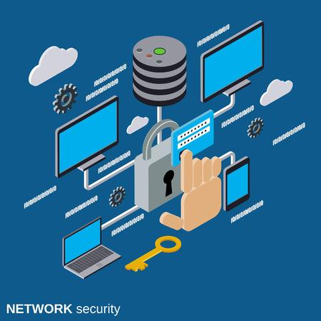
Explanation
4.Data Storage:
Event Logging:Stores logs for auditing and analysis.
Threat Intel Database:Maintains known threats for reference.
5.Security Operations Center (SOC):
Analysts: Monitor, investigate, and respond to alerts.
Incident Response Team: Coordinates incident response activities.
6.External Integrations:
Threat Feeds: Integrates for real-time intelligence.
Collaboration Tools: Connects for team communication during incidents.
7.Compliance and Policy Management:
Policy Engine:Enforces security policies and ensures regulatory compliance.
Security Awareness Training: Educates employees on security best practices.
8.Monitoring and Analytics:
SIEM:Collects, analyzes, and correlates security events.
Dashboard Tools: Provides visualizations and reports for security performance.

Slide 26
Recommendations
1. Ensure the UI Dashboard is user-friendly, intuitive, and provides a comprehensive overview of the security landscape with customizable widgets and real-time updates.
2. Enhance the reporting module for more insightful reports, including trend analysis, KPIs, and actionable recommendations.
3. Implement automation to streamline incident resolution, reducing response times and minimizing errors.
4. Continuously expand integration with emerging tools and foster collaborations for enhanced threat intelligence and incident response.
5. Invest in ongoing training and refinement of detection engine ML models, staying updated on the latest anomaly detection advancements for increased accuracy.
6. Regularly update filters and explore advanced tech for improved prevention of evolving email threats.
7. Keep security updated with the latest threat intel and conduct regular awareness training to minimize risks.
8. Regularly update firewall and IPS rules, and conduct assessments to address VPN vulnerabilities.
9. Implement secure, scalable storage for logs and threat intel databases, regularly auditing for compliance and efficiency.
10. Provide ongoing training, fostering a culture of continuous learning and improvement within the SOC team.

Slide 27
Conclusion
In conclusion, ABC IT Security is well-equipped, but continuous improvement is vital for staying ahead in digital security. Implementing the outlined recommendations ensures a proactive and resilient approach, emphasizing regular assessments, training, and collaboration to maintain top-tier email security standards.

Slide 28
Thank You

